Slide 1



Quantitative Research for Qualitative Researchers
8th-10th January 2019
Cardiff University
Day One

Slide 2
Welcome

Slide 3
Aims & Objectives
This is not a statistics course!
We assume no background in quantitative methods (so apologies in advance for over-simplification)
By the end of the course participants will:
  Understand the reasoning underlying quantitative methods and their role in a pluralist approach to research
  Learn about basic design issues and how these inform methodological choices
  Be introduced to basic sampling decisions and techniques
  Learn how to go about designing a questionnaire and measure through simple scales
  Be aware of the possibilities of using existing data to answer research questions
  Learn about univariate and bivariate analysis
  Understand the concepts of central tendency and dispersion
  Learn how to use some simple descriptive statistics

Slide 4
Participation Is Key
The workshop is interactive
Please ask questions/make observations
Group work tasks
What happens in this room stays in this room!
Feel free to discuss your own work

Slide 5
The Indispensability of Quality and Quantity

Slide 6
Back to Basics - How do we know the social world?
Lets begin by forgetting/ ignoring partisan arguments!
The social world is a dynamic, complex and emergent ensemble of interactions between people and people and people and the physical world
No one tool, or set of tools will suffice to provide sufficient, actionable knowledge of it
Question: What kinds of potential knowledge can we have of the social world? Can we think of some examples? Are there limits on knowledge?

Slide 7
Types of Social Knowledge
Understanding
Description
Explanation
How do these link together?

Slide 8
Some ways in which understanding, description and explanation connect
Thin description (things, situations, places, appearances) Thick description (understanding types of meaning)
Understanding Possible explanations of how/ why meanings exist/ shared.
Quantitative description of events, people, things in the world Understanding of their meaning

Slide 9
Quantitative and Qualitative Research
Often they are interlinked through ‘mixed methods’ and there is an iterative process through description, understanding, explanation
A great deal of quantitative research is only descriptive
Quantitative and qualitative research can ‘seek causes’, the first at a micro- level, the second at a macro and probabilistic level.

Slide 10
De-bunking Myths of Quantitative Methods
They are not necessarily ‘positivist’, though always ‘naturalist’
They do not claim to tell us everything and anything about the social world
They are not ‘determinist’ but probabilist
They can combine with qualitative methods
‘Inherent indeterminateness in the lifeworld’ (Denzin) is an exaggeration. QM can be used to study both order and disruption
They do not reify number and perpetuate oppressive hegemonies
They do not reify complex statistical procedures

Slide 11
Why we need quantitative methods – a feminist and indigenous perspective
If an argument is needed for this I think that it is to be found in the fact that feminism in all its various varieties does understand itself to be a radical movement for social change. It aims at producing societies which are more than those it finds already in existence. Surely the rhetorical wing of feminism will require descriptions and analyses of the social arrangements about which the judgements about justice and injustice are being made, as well as explanations of how they come about and are sustained in existence.
Ismay Barwell 1994: 82
Quantitative research methodologies, they research practice they engender, and the skills base to interpret and use them are central to validating our declaration of research self- determination.
Walter and Anderson 2013: 136

Slide 12
Group Activity: Your Own Research
In groups of two or three describe to each other your research – and methodological interests
How do the concepts of description, explanation and understanding apply?
Then………your partner will very briefly sum this up for the wider group

Slide 13
Coffee Break

Slide 14
Research Design and Surveys

Slide 15
Beginning Research Design
Anticipate alternative explanations before collecting data
Design the collection to obtain context and comparisons. This will reduce ambiguity of data
Building these comparisons in = design

Slide 16
Quantitative research is often about comparisons
Between groups (male, female)
Between units (organisations, countries, regions)
Between time points (before/after, individual unit over time/case study, groups over time)
Comparisons are immediately aggregate descriptions of population segments
Comparisons can facilitate/ evaluate causal explanations and they drive the logic of design
Four main designs: Cross sectional, Longitudinal, Experimental, Case Study
So …..when we think of design we think of methodological design and method design

Slide 17
Cross Sectional Designs
Useful to provide descriptions
No time dimension
Data collected at one point of time
About one point in time
Based entirely on comparisons between groups
Difficult to demonstrate causality (correlation is not causality!)

Slide 18
Longitudinal Designs I
Describe sequences of events
Measures continuity over time
Measures change over time

Slide 19
Longitudinal Designs II
Prospective
  Panel
    Cohort (e.g. birth,)
    Broad sample (Household surveys e.g. Understanding Society)
  Time series/ repeated surveys
    Rates figures (Birth, divorce, marriage, crime)
    British Social Attitudes Survey
    Census (although panel version is possible)

Slide 20
Longitudinal Designs III
Retrospective
  Collected at one point of time
  Individual reconstructions
    Life course events
    Workforce history
    Housing history
  Parents characteristics
    Social mobility studies

Slide 21
Case Studies
Case based rather than variable based
Context provided by
  Examining whole case
  Context in which case exists
Single case studies
Comparative case studies
Data in depth
Logic of analysis
  Methods of difference
Methods of similarity

Slide 22
Experimental designs
Control for change holding other variables constant
Uses experimental and control groups
Difficult to control for violations of assumptions in the social world, but quasi experiments might be used..

Slide 23
Research Design: Key Point
What is important to note is that the method is independent of the design and each design may incorporate more than one method
E.g Experiments may use surveys and outcome measures. The ‘case’ could be an individual (n of 1) or, a community. Longitudinal research may combine secondary analysis, with depth interviews

Slide 24
Survey Design: Format
Face to face interviews
Self completion (email, Web, Smartphone, postal, on site etc)
Telephone CATI
CAPI

Slide 25
Survey Design: Principles
The five essential ingredients of good questionnaires
Good survey design depends on:
  Representative sample
  Reliable and valid questions
  Clear presentation
  Rigorous piloting

Slide 26
Survey Design: Why, Who, Where and When?
State clearly what it is you want to know. Preferably in the form of a ‘research hypothesis’. Will a survey provide the answers?
Where/ what is your ‘population’? Can they answer your questions? Will they answer your questions?
When are you going to conduct your survey?

Slide 27
Secondary Data
Major problem of primary surveys is resource
Secondary analysis of large datasets can provide more sophisticated analyses, because of larger samples
UK has large number of excellent datasets, several of them panel studies, permitting longitudinal analyses
May require researcher ‘accommodation’ in respect of what is asked
But….strategies such as computing new variables, recoding, imputation and data merging possible
Thinking of a survey? Maybe, but why have a dog and bark yourself?

Slide 28


Sources of Secondary Data I
UK Data Service (UKDS)
  https://www.ukdataservice.ac.uk/
  Full of archived datasets
  Including qualitative data: https://www.ukdataservice.ac.uk/get-data/key-data/qualitative-and-mixed-methods-data
Survey Question Bank
  https://discover.ukdataservice.ac.uk/variables
  Identify good question and trace source
The Office for National Statistics
  www.statistics.gov.uk
  Neighbourhood statistics, Census data etc…

Slide 29




Sources of Secondary Data II
Newspapers (LexisNexis?)
Company of organisation reports
Government departments (Defence, Health)
OFSTED/ESTYN reports
Archived Documents
Parliamentary research papers (Hansard?)
Social Media…

Slide 30
Group Activity: Design and Method
How might we research these topics?
  Attitudes/ problems concerning disabled access to government buildings
  Measuring household size and composition in London
  The experience of widowhood
  Public views on congestion charging
  The provision of sports facilities for young people

Slide 31
Lunch

Slide 32
Introduction to Sampling

Slide 33
Sampling Overview
Essentially there are two groups of sampling techniques…
PROBABILITY SAMPLING
Every individual in the population has as equal a chance of being sampled as anyone else
Random Sample
Systematic Sample
Stratified Random Sample
NON-PROBABILITY SAMPLING
Some individuals in the population have a higher chance of being sampled than others
Convenience Sample
Snowball Sample
Quota Sample (e.g. by sex, age)
Truly ‘random’ is very hard to achieve
Quota aims to emulate probability

Slide 34
Probability Sampling
First select the population, then consider the sample
Everyone in the population should have an equal chance of selection
Requires a sample frame
Types of selection. Random numbers, random start, random walk etc.
Size and Proportionality. A small sample of a large population may be more representative than a large sample of a small population
Homogeneity - v – heterogeneity
‘Booster’ samples for under-represented groups

Slide 35
Accuracy and Confidence
Accuracy of a sample assessed through the confidence level and the amount of error
Confidence level usually set at 95%. E.g….
  Labour 41%
  Conservative 39%
  Liberal Democrat 14%
  Other 6%
  +/- 3% at 95% confidence level
Thus 95% of the time we can be comfortable that the sample reflects the population by + or – 3%. Is the election too close to call?

Slide 36
Sample Size at 95% Confidence Level

Slide 37
Sampling Considerations
Increasing the size of a small sample can significantly reduce sampling error. If you increase a sample size from 100 to 156 sampling error can be reduced by 2%
But……as samples get very big, there are diminishing returns –v- resource costs
Calculations are for a simple probability sample
May need to stratify
May need to over sample certain groups
May need to use quota or other sampling strategy

Slide 38
Sampling Problems
(not an exhaustive list!)
No / Incomplete sampling frame
What if there is a systematic error in random starts?
What groups do you use for stratification?
Non response
Heterogeneity & poor significance
Problems of geography / location
Rare/ illusive populations
Will your quotas describe your population?
Is a convenience sample representative?

Slide 39
Sampling – A Recap
How might we recruit university students for a study…
Random Sample
  Let a computer decide based on student ID
Systematic Sample
  Take every 20th student in an unordered list
Stratified Random Sample
  Randomly select students from different subjects
Convenience Sample
  Select the students you meet outside of the library
Snowball Sample
  Find one student you want to interview and ask them to find others
Quota Sample (e.g. by sex)
  Select students outside Union but ensuring a 50/50 male-female split

Slide 40
Group Activity: Sampling Strategies
What might the sampling strategy be for…
  A survey of public attitudes to recycling?
  Facilities for homeless people in Brighton?
  Views on adult education in Reading?
  Tourist attitudes toward facilities in Edinburgh?

Slide 41
Coffee Break

Slide 42
Asking (Good) Questions

Slide 43
Quick Recap
State clearly what it is you want to know. Will a survey provide the answers?
Who are you surveying and can they give you the answers?
Where is your ‘population’? Can they answer your questions? Will they answer your questions?
What medium of data collection (Web, Email, Face to Face, paper self completion, telephone?
When are you going to conduct your survey?

Slide 44
Questions: First thoughts
Questions are measurements
Questions often start as general, but must become sharpened and focussed in the design phase
The kinds of questions you can use will depend on the type of survey and your resources for analysis
You must always bear in mind how you are going to analyse your questionnaire (levels of measurement, dependent/ independent variables/ control variables) – more on this later!

Slide 45
Example: Asking About Child Poverty
What counts as a child? Under 10 years?
Identify the target population (where and who do we ask?)
What counts as child poverty? E.g. Low birth weights, under nourishment, poor cognitive abilities
What do we want to find out?
What are the day to day conditions of the parents and children, e.g…
  how many children, their ages, unemployment/ employment patterns, housing conditions, household income, single parent families, teenage pregnancy, limiting long term illness, household diet, childcare arrangements…
Characteristics of children
Attitudes to childcare/ lifestyle etc.

Slide 46
The Questions Themselves…..
Are used/ adapted from previous instruments
Are the result of development/ pre-testing/ piloting.
….or we just made them up!

Slide 47
Background Considerations
Will the respondents understand / be capable of participating?
Possible factors to consider are:
  Age
  Disability
  Ethnicity
Completing a questionnaire or answering interviewer questions requires a great deal of tacit knowledge that we should not take for granted
It is a social performance

Slide 48
Types of Questions
Generally we think of survey questions as consisting of general three types…
Those concerned with facts
  ‘What is the postcode of where you live?’
Those concerned with behaviour
  ‘How often do you use Poppleton Leisure Centre?’
Those concerned with attitudes/beliefs
  ‘To what extent do you agree with the following statement: ‘The cost of Poppleton Leisure Centre redevelopment was money well spent’

Slide 49
How to Ask Bad Questions!
Avoid general (unspecific) questions
  ‘How satisfied are you with your job?’
Avoid double-barrelled questions
  ‘How satisfied are you with your job and pay?’
Avoid negatives (and double negatives!)
  ‘Do you not agree with not reviewing your pay?’
Don’t make people answer irrelevant questions
  ‘How much do you earn?’ to someone who is unemployed
ALWAYS PILOT YOUR DATA COLLECTION INSTRUMENT!

Slide 50
Group Activity: Rewriting Questions
Working in pairs, rewrite the questions below…
  How long have you been in London?
  Do you believe in animal experiments?
  ‘The council have decided to introduce a new way of collecting recyclable material from households. Do you think that separating glass, cardboard and metal would make it easier or harder for you to recycle materials or would it make no difference?
Tip: Some might need breaking down into more than one question

Slide 51
Asking About ‘Sensitive’ Things
Asking about apparently sensitive things is easier than you might think
Scenarios, examples, Lickert scale items, ‘show cards’/ ‘sorting cards’ in face to face interviews
Age – best way to ask is this: What was your age last birthday? Straight to the point, unambiguous and allows re-coding later
Asking about income: After deductions such as income tax and National Insurance how much do you earn each week? Please tell me which band on this card your weekly earnings are in. nb. Weekly is used in this example, but may not always be appropriate

Slide 52
Have You Murdered Your Wife?
(after Barton 1958)
There are several indirect approaches
  The casual approach: ‘Do you happen to have murdered your wife?’
  The numbered card approach: ‘Will you please read off the number of this card which corresponds with what became of your wife?’
  The everybody approach: ‘As you know, many people have been killing their wives these days. Do you happen to have killed yours?’

Slide 53
Visual Aids
Some questions may be better asked with the use of prompt cards e.g….
  After deductions such as income tax and National Insurance how much do you earn each week? Please tell me which band on this card your weekly earnings are in:
Band A | Nothing to £99 per week
Band B | £100 to £199 per week
Band C | £200 to £299 per week
Band D | £300 to £399 per week
Band E | £400 to £499 per week
Band F | £500 to £599 per week
Band G | More than £599 per week

Slide 54
Categorical Questions
Which means of transport did you use to complete the longest part of your journey today? (Please tick one)
Bus
Train
Car
Bicycle
Motorcycle
Walking
Other

Slide 55
Multiple Item Categorical Questions
Which of the following items do you have in your kitchen? (Please tick all that apply)
Electric kettle
Electric toaster
Microwave
Dishwasher
Food processor
Deep fat fryer
Juicer

Slide 56
Ordered Categories
How do you rate your chances of promotion in the next five years? Would you say they were:
Very High
High
Low
Very Low
Not Sure

Slide 57
Group Activity: Questioning Health
Consider how best to ask about the health of a respondent…
Write down rough initial questions that arise from the issue to be surveyed
Work out what is ‘face sheet’ information
  This consists of personal information you may need such as age, sex, place of residence, occupation, tenure and so on
Devise three questions to ask about a respondent’s current health

Slide 58
Quantitative Research for Qualitative Researchers
8th-10th January 2019
Cardiff University
End of Day One!

Slide 59
Quantitative Research for Qualitative Researchers
8th-10th January 2019
Cardiff University
Day Two

Slide 60
A (brief) Introduction to Scales

Slide 61
Scales and When to Use Them
Sometimes called ‘attitude scales’
Can collapse a lot of questions about attitudes and beliefs
Often uses positive and negative statements to measure the same thing
Ordering and testing each statement is important

Slide 62
Scales and when to use them
Opposites often used and same question asked differently (to avoid a ‘response set’)
Allows a validity check
Two most frequently used scales:
  Likert scale
  Semantic differential scale

Slide 63
Do you agree or disagree with the following statements?
 | Agree | Disagree | Not sure
I found school maths easy
In my university work I would rather write an essay than use statistics
Statistics are for geeks
On the whole you can’t trust statistics
I feel confident about learning statistics
Good numeric skills will help me get a job
I enjoyed maths at school
I could turn to my parents with maths help
One of the reasons I chose this degree is because I don’t like maths.

Slide 64
A Likert Scale

Slide 65
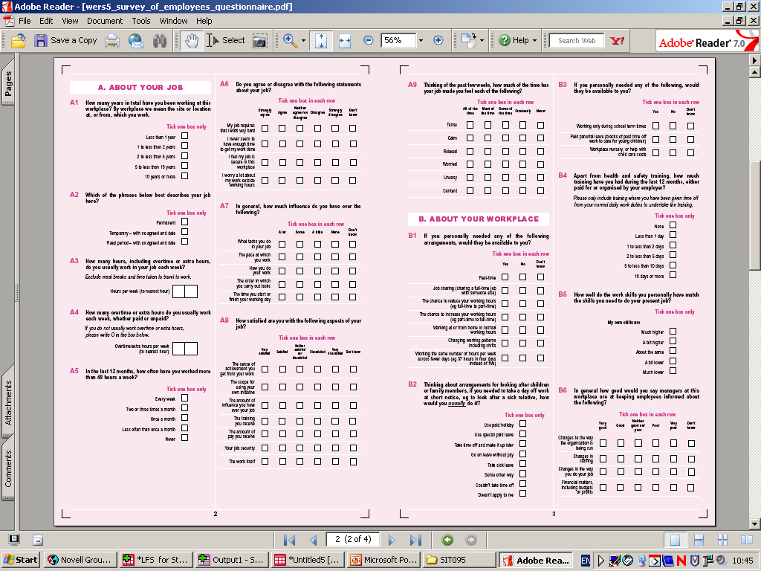

Slide 66
Scales and when to use them
Compose an item pool. Avoid too many ‘neutral’ items or extremes
Test on a group of people with similar attributes
Get them to weight in importance the item
The issue of the ‘neutral’ (neither agree/ disagree etc.) and sufficient knowledge/commitment

Slide 67
Semantic Differential Scales
Respondents are asked to situate their attitudes on a scale ranging between opposite positions
Points on scale should not be treated as precise equals
Nine, seven, five or three points used
Important to develop and test range of semantic opposites

Slide 68
Survey Design

Slide 69


Slide 71
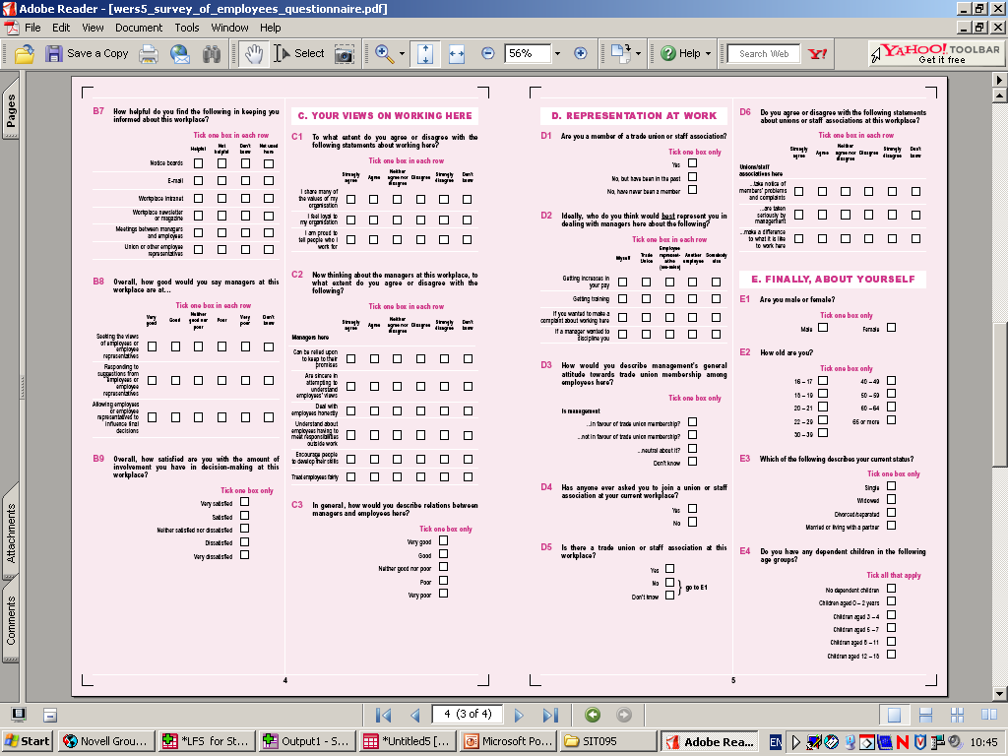

Slide 72
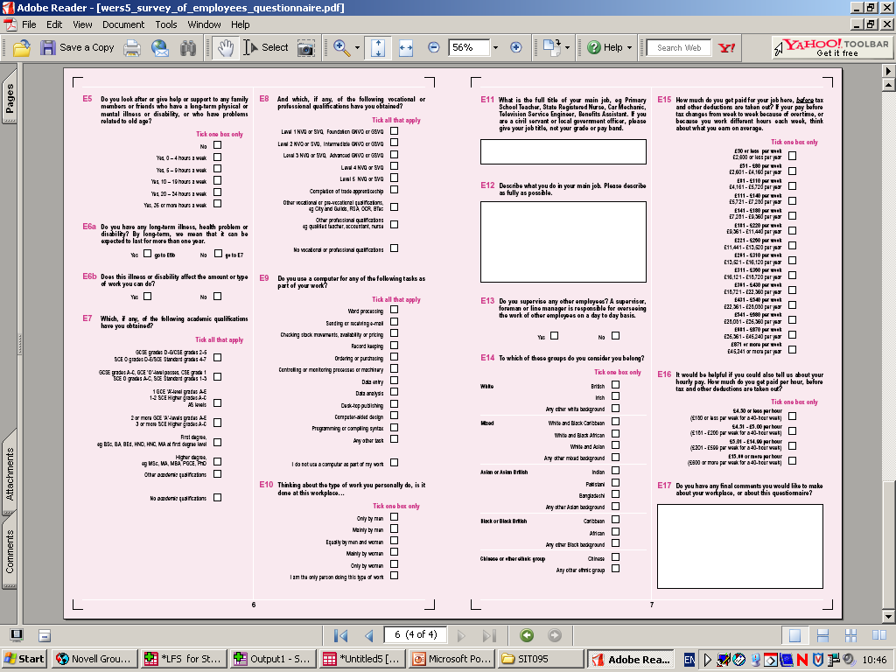

Slide 73
Operational Issues in Surveys
How will the survey be administered?
How will respondents reply?
How will you manage your respondents (e.g. follow-ups for non-response)?
What about incentives?

Slide 74
Technical Issues in surveys
We need to think about how the data will ‘look’ after it has been collected and this is completely reliant on the questions we ask and the response options we offer
‘Variable’ is the generic term for a set of responses associated with an individual question or measurement e.g. ‘SEX’, ‘AGE’, ‘ETHNICITY’ etc…
Variables are how we operationalise social concepts
But not all variables are equal!
Different coding strategies exist for different ‘levels of data’

Slide 75
Variables & Levels of Measurement I
Data Level | Description | Examples
Nominal (categorical) | Response categories cannot be placed in a specific order – impossible to judge ‘distance’ between categories | Sex (Male/Female) Ethnicity (White/Black…) Party (Lab/Con/LD…)
Ordinal (categorical) | Response categories can be placed in rank order – distance between categories cannot be measured mathematically | Likert (Agree/Neutral/Disagree) Rank Preference (Coke/Pepsi…) Education (GCSE/A-Level…)
Interval (or continuous)* | Responses measured on a continuous scale with rank order – uniform distance between responses allows mathematical measurement | Age (in years) Income (in £)
Source: David & Sutton (2004)
*NOTE: Interval = no true zero point (e.g. height), Ratio = true zero point (e.g. income)

Slide 76
Variables & Levels of Measurement II
Level of measurement for certain variables is not pre-defined:
  AGE (in years e.g. 22, 34, 54)
  AGE (pre-set bands e.g. 18-30, 31-50)
  AGE (group membership e.g. mature student)
There is a hierarchy of data – always try to collect the highest level possible to maximise usefulness!
  Are you bored? (Yes/No)
  On a scale of 1-10, how bored are you [where 1=‘practically in tears of boredom’ and 10=‘riveted’]

Slide 77
Survey Design & Coding I
Levels of measurement MUST be considered at the research design phase
This will allow you to plan your analyses effectively before data collection
Piloting your survey will provide an excellent opportunity to test your coding
Your SPSS datasheet should be set-up before data collection!

Slide 78
Survey Design & Coding II
To code simple categorical data…
Q: What is your ethnicity?
White:
British
Irish
Any other White background
Mixed:
White and Black Caribbean
White and Black African
White and Asian
Any other mixed background
Asian or Asian British:
Indian
Pakistani
Bangladeshi
Any other Asian background
1
2
3
4
5
6
7
8
9
10
11
Black or Black British:
Caribbean
African
Any other Black background
Other Ethnic Groups:
Chinese
Any other ethnic group
12
13
14
15
16
Source: Ethnic Category Codes (NHS)

Slide 79
Survey Design & Coding III
To code simple ordinal data…
To what extent do you agree or disagree with the following statements?
1 2 3 4 5
 | Strongly Agree | Agree | Neutral | Disagree | Strongly Disagree
I love learning about coding
Levels of measurement make my day
I’m thinking about dinner tonight
Q1
Q2
Q3
Source: SI0030 Cohort 2011?

Slide 80
Survey Design & Coding IV
To code simple interval data…
What was your age last birthday?
……………. yrs
No coding needed! Simply enter the value directly into SPSS

Slide 81
‘Other – Please Specify’
Sometimes it is impractical to offer all responses to a question
E.g. What is your favourite beer?
Think about how you will code the ‘Other’ response
One variable for ‘Other’ and one ‘string’?

Slide 82
Missing Data
Sometimes respondents will miss questions – either accidentally or on purpose
Differentiate between ‘Not Applicable’ and missing
Good practice with missing data = ‘99’ or ‘-99’

Slide 83
Resolving Problematic Variables
Sometimes you will need more than one variable to code a single question…
Level | Question Type | Problem | Answer
Nominal (categorical) | Tick all that apply (e.g. papers read, things owned, lectures attended etc.) | Many responses to a single question – how to code? | Variable for each response with binary coding
Ordinal (categorical) | Rank in order of preference (e.g. beers, cheeses, crisps, cars, lecturers etc.) | Multiple responses to code where rank matters – what variables to use? | Variable for each product with rank order coding OR variable for each rank with code for each product

Slide 84
Resolving Problematic Respondents
Good practice to give respondents an ID
ID may be removed
Writing ‘2.5’ on a discrete 5-point scale
Uniform response from single respondent
Respondent ‘humour’ (150 years old!)

Slide 85
The Things People Say…
One person said that they lived in the basement of an abandoned opera theatre
Four people communicated with their friends using an owl/pigeon/tin can and string
One person is ‘scared of flags’
One person ‘ate their siblings’
What do you treat as ‘truth’?

Slide 86
Coffee Break

Slide 87
Introduction to SurveyMonkey
Go to www.surveymonkey.com
Sign up for free
Limit of 10 questions and 100 responses
Cannot download data (e.g. in .xls format)
Let’s get started!

Slide 88
Group Activity: SurveyMonkey
Working in pairs, have a go at recreating the following questions in SurveyMonkey
Pay particular care to the response parameters…
Precarious learning!

Slide 89
Question: | Response: | Parameters:
Which of the following describes how you think of yourself? | Male, Female, In another way, Prefer not to say | Select one answer
What was your age last birthday? | [age in years] | Numeric answer
Which of these age groups do you belong in? | <18, 18-20, 21-30, 31-40, 41-50, 50+ | Select one answer
Which of these newspapers have you read in the past month? | The Guardian, The Times, The Telegraph, The Sun, Metro, Other (please specify) | Tick all that apply & allow ‘other’ response in text
Rank these soft drinks in order of preference (where 1 = most preferable and 4 = least preferable) | Coke, Pepsi, Sprite, Tango | No two items can be given the same rank & respondents must rank all items
To what extent do you agree with these statements: a) SurveyMonkey is fun b) I want to go home now | Strongly Agree, Agree, Neither Agree or Disagree, Disagree, Strongly Disagree | Only one answer per statement

Slide 90
Introduction to SPSS and Analysis

Slide 91
Why Do We Use It?
Despite appearances, SPSS makes data analysis simpler!
Because it uses a graphical user interface (GUI) you don’t need to remember/understand any algebra or formulas
Syntax console accommodates more bespoke and specialist analysis
It allows you to import data from .xls .xlsx .txt .csv .dbf

Slide 92
Opinions and Lifestyle Survey
For this training we are using a specially designed Teaching Dataset
Opinions and Lifestyle Survey (Well-Being Module), April-May 2015
Unrestricted Access
https://discover.ukdataservice.ac.uk/catalogue?sn=7913#administrative

Slide 93
Tour of Basic Functions
Opening a dataset
Saving a dataset (.sav and .spv)
Data view
Variable view
Output window

Slide 94
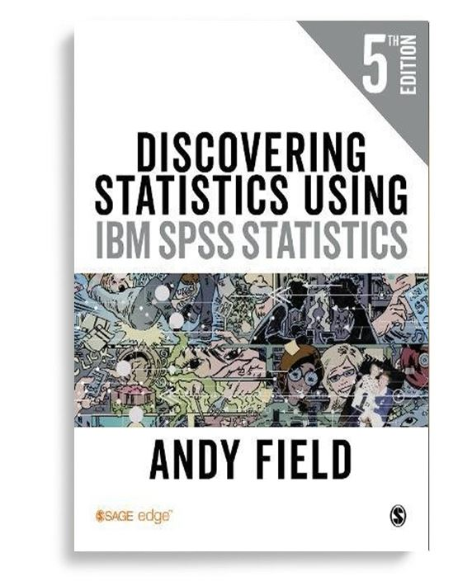

Recommended…
Pallant, J. (2016) SPSS Survival Manual 6th Ed. Maidenhead: McGraw Hill
Field, A. (2017) Discovering Statistics Using IBM SPSS Statistics 4th Ed. London: SAGE

Slide 95
Group Activity – Where’s Wally?
Unfortunately this is not as interesting as it sounds…
Working in pairs, try to locate the following list of operations from the tool bar:
Command: | What It Does:
‘Compute Variable’ | Creates a new variable using existing data
‘Scatter/Dot’ | Generates a scatterplot
‘Select Cases’ | Allows you to select specific cases
‘Save As’ | Saves file with new name
‘Frequencies’ | Lists all values for a variable & number of occurrences
‘Crosstabs’ | Looks at differences between groups (e.g. chi-square)
‘Independent Samples T Test’ | Looks at differences between groups
‘Multilayer Perceptron’ | Performs neural network analysis

Slide 96
Lunch

Slide 97
Describing Data and Univariate Analysis

Slide 98
An epistemological pause!

Slide 99
Frequencies & Fidelity I
Frequency tables display the number of times that a value appears in your dataset (per variable across all cases)
Highlights data errors
Indicative of potential analysis

Slide 100
Frequencies & Fidelity II
Error?
What can we say about this table?
Parties coded
 |  | Frequency | Percent | Valid Percent | Cumulative Percent
Valid | -9 | 1 | .0 | .0 | .0
 | Conservative | 1331 | 29.9 | 29.9 | 30.0
 | Labour | 1103 | 24.8 | 24.8 | 54.8
 | Lib Dem | 1044 | 23.5 | 23.5 | 78.2
 | Green | 368 | 8.3 | 8.3 | 86.5
 | UKIP | 171 | 3.8 | 3.8 | 90.4
 | BNP | 78 | 1.8 | 1.8 | 92.1
 | Independent | 216 | 4.9 | 4.9 | 97.0
 | Others | 135 | 3.0 | 3.0 | 100.0
 | Total | 4447 | 100.0 | 100.0
Missing | System | 1 | .0
Total |  | 4448 | 100.0
What we would expect?
Look at %s
More than UKIP
What’s this?
Really? Only 1?
A simple frequency table can tell you quite a bit!

Slide 101
Group Activity – Find the Errors!
Open ‘OLS_Survey_2015_TRAINING_v2.sav’
Run frequency tables to find the input errors for the following variables ‘RSEX’, ‘MCZ_3’, ‘Ethnicity2r’, ‘FtPtWkr’
To create a frequency table go to ‘Analyze’, ‘Descriptive Statistics’ and ‘Frequencies’
Remember to look at the ‘Values’ field in the ‘Variable View’ to see permitted responses
To find and rectify the problematic value:
  go into ‘Data View’ & highlight the variable column
  click on the binoculars on the tool bar
  type in the problematic value & click ‘Find Next’
  replace problematic value with ‘99’ (i.e. missing)
Always consider whether the answer is likely to be feasible…

Slide 102
Coffee Break

Slide 103
Central Tendency I
You have all done quantitative research and you all use measures of central tendency in your normal lives – the average, middle and most common values
What to eat for dinner?
Decide based on the most popular choice
Most Common
(MODE)
How long do you cook a chicken?
Cookbook says 2 hours but internet says 3
Middle
(MEDIAN)
How to split the bill equally?
Divide total amount by number people
Average
(MEAN)

Slide 104
Central Tendency II
MODE
the value that occurs the most frequently in the data
MODE = 32

Slide 105
Central Tendency III
The mode is useful for thinking about NOMINAL data
The most frequent (MODAL) response

Slide 106
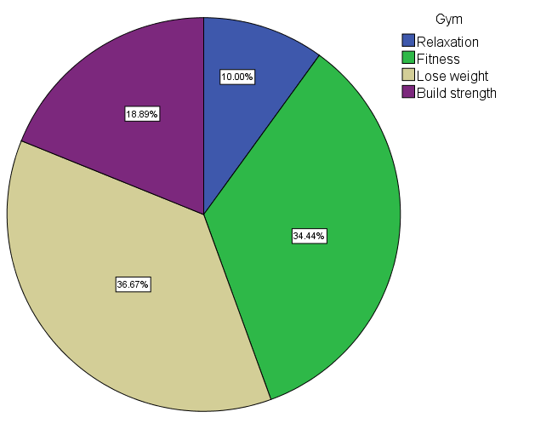
Central Tendency IV
NOMINAL data can be displayed using a pie chart

Slide 107
Central Tendency V
MEDIAN
the middle value of the ordered sample data
When the sample size if odd, the median is the middle value
When the sample size if even, the median is the midpoint of the two middle values
MEDIAN = 42.5

Slide 108
Central Tendency VI
The mode and median are useful for thinking about ORDINAL data
There is a general lack of public knowledge about local government
 |  | Frequency | Percent | Valid Percent | Cumulative Percent
Valid | Strongly Agree | 1911 | 41.1 | 41.8 | 41.8
 | Agree | 2281 | 49.1 | 49.9 | 91.6
 | Neutral | 255 | 5.5 | 5.6 | 97.2
 | Disagree | 111 | 2.4 | 2.4 | 99.6
 | Strongly Disagree | 17 | .4 | .4 | 100.0
 | Total | 4575 | 98.5 | 100.0
Missing | System | 71 | 1.5
Total |  | 4646 | 100.0
This is the middle (MEDIAN) response
This is the most frequent (MODAL) response

Slide 109
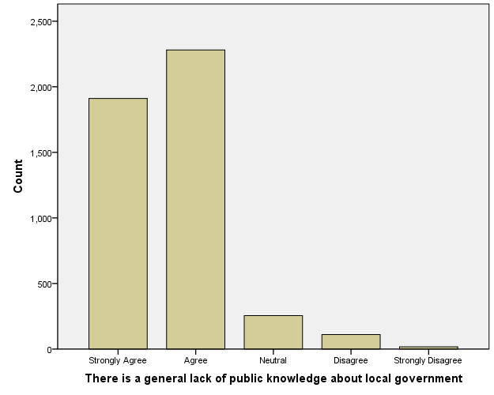
Central Tendency VII
ORDINAL data can also be displayed using a bar chart

Slide 110
Central Tendency VIII
MEAN
sum of the value divided by the number of cases
442
MEAN = 44.2
10

Slide 111
Central Tendency IX
The mean, mode and median are useful for thinking about INTERVAL data
Statistics
What was your age last birthday
N | Valid | 4290
 | Missing | 158
Mean |  | 54.74
Median |  | 57.00
Mode |  | 62
This is the MEAN age
This is the MEDIAN age
This is the MODAL age

Slide 112
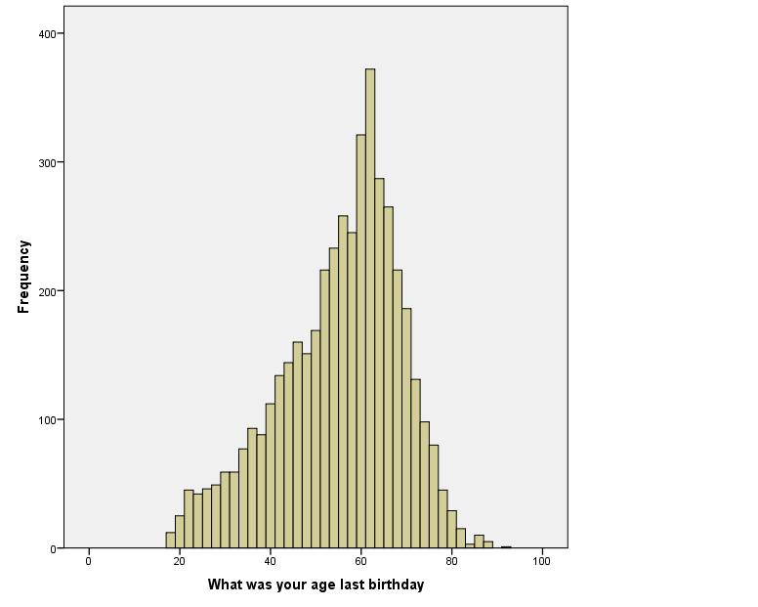
Central Tendency X
INTERVAL data can be displayed using a histogram

Slide 113
Dispersion I
Measures of central tendency are heuristics
They can hide important details in the data
Dataset 1: | 1 | 2 | 3 | 4 | 5 | 6 | 7 | 8 | 9
MEAN = 5 MEDIAN = 5
Dataset 2: | 1 | 2 | 3 | 4 | 5 | 6 | 7 | 8 | 90
MEAN = 14 MEDIAN = 5
Need to consider RANGE and STANDARD DEVIATION

Slide 114
Dispersion II
RANGE measures the difference between the lowest and highest values
  Large range may reveal outliers (dataset 2!)
  Small range suggests tight grouping of data
STANDARD DEVIATION (SD) measures the average distance (deviation) of each value from the mean
  Large SDs occur when data points are a long way from the mean (wide range of different values)
  Small SDs occur when data points are close to the mean (values do not differ very much)

Slide 115
Dispersion III
For example:
Age (Sample 1) | Age (Sample 2)
18 30 23 31 21 19 20 19 28 21 | 8 55 53 13 12 52 7 9 11 10
Descriptive Statistics
 | N | Range | Minimum | Maximum | Mean | Std. Deviation
Age | 10 | 13.00 | 18.00 | 31.00 | 23.0000 | 4.85341
Valid N (listwise) | 10
Descriptive Statistics
 | N | Range | Minimum | Maximum | Mean | Std. Deviation
Age | 10 | 48.00 | 7.00 | 55.00 | 23.0000 | 21.01851
Valid N (listwise) | 10

Slide 116
Group Activity – Descriptive Statistics I
Work in pairs or small groups
Go to ‘Analyze’, ‘Descriptive Statistics’ and ‘Frequencies’
Drag and drop the variables you want to be analysed in the ‘Variable(s)’ box
Click the ‘Statistics’ button to select which descriptive statistics you want to generate

Slide 117
Group Activity – Descriptive Statistics II
Using this method write down the answers to the following questions:
  What is the mean score for how happy people felt yesterday?
  What is the modal value for marital status?
  What is the median for health in general?
  What is the range for satisfaction with mental well-being?
  Is there a difference in the standard deviations between satisfaction with financial situation and overall satisfaction with life nowadays?

Slide 118
Graphs vs. Tables
Often frequency tables are too large or cumbersome to display data effectively (as you’ve just seen!)
An alternative way to display quantitative data is through using graphs
As a rough guide…
  Pie charts are good for nominal data (male/female)
  Bar charts are good for ordinal data (attitudinal scales)
  Histograms are good for interval data (scores)

Slide 119
Group Activity – Generating Graphs
To create a graph go to ‘Graphs’, ‘Legacy Dialogs’ and select the graph type.
Generate an appropriate graph for:
  Full-time or part-time employment status [‘FtPtWkr’]
  Age groups [‘AGEXr’]
  Satisfaction with physical health [‘MCZ_7’]
NOTE: for all of these graphs click ‘Define’ without making any changes to the options (if this window appears before you get to the window in which you can drag and drop variables)

Slide 120
Quantitative Research for Qualitative Researchers
8th-10th January 2019
Cardiff University
End of Day Two!

Slide 121
Quantitative Research for Qualitative Researchers
8th-10th January 2019
Cardiff University
Day Three

Slide 122
Exploring Relationships – Bivariate Analysis

Slide 123
Comparing Groups
‘Bivariate’ simply means ‘two variables’ and is used to denote a plethora of techniques that look at the differences between groups
You can only look at the differences between groups if you have:
  a) a grouping variable (male/female, Lab/Con/LD)
  b) a variable that you expect to differ between groups (income, alcohol consumption, car ownership)
We will cover one common technique for comparing groups where both variables are categorical

Slide 124
Crosstabulations I
Crosstabulations provide a means through which we can observe, measure and comment upon the relationship between two categorical variables
Remember that categorical can include both nominal and ordinal data
Crosstabulations present the relationship between the two variables in a table (e.g. whether playing computer games is related to the sex of a respondent)

Slide 125
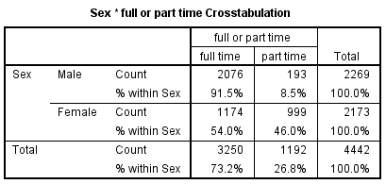
Crosstabulations II
For example, in the crosstabulation below we’re investigating the association between sex and whether someone works full-time or part-time
Talk to the person next to you – what would you conclude from this table?

Slide 126
Chi-Square Test For Independence I
Can be used to establish whether there are statistically significant relationships between two categorical variables (nominal/ordinal)
e.g. Is there a statistically significant relationship between sex and full-time or part-time work?
In other words, is full-time or part-time working INDEPENDENT of sex or not?
The test should do nothing more than confirm what you already suspect from interpreting the table…

Slide 127
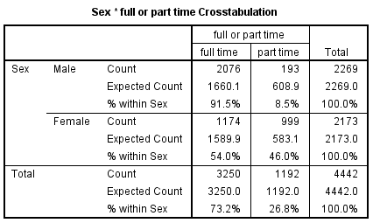
Chi-Square Test For Independence II
The chi-square test for independence uses the crosstabulation to measure the difference between the expected and actual values
Expected = the distribution of responses if there was no relationship
Actual = how the responses are actually distributed

Slide 128
Chi-Square Test For Independence III
A large discrepancy between the two measures may indicate disproportionality i.e. a statistically significant association or dependency between variables
If cell counts go under 5 then we start to undermine one of the assumptions of the test (I’ll explain this as we go)
Whilst the raw counts are used for the formal test, it’s best to use percentages to interpret and make sense of the crosstabulation
Let’s work through an example together…

Slide 129
Group Activity: Social Class & Health I
Is there a relationship between social class (NS-SEC) and self-perception of general health?
Select ‘Analyse’, ‘Descriptive Statistics’, ‘Crosstabs’
Drag and drop the social class variable into the ‘Row(s)’ box
Drag and drop the general health variable into the ‘Column(s)’ box
Click on ‘Statistics’, select ‘Chi-Square’ and click ‘Continue’
Click on ‘Cells’, select ‘Row’ (under ‘Percentages’) and click ‘Continue’
Click ‘OK’ to run the analysis

Slide 130
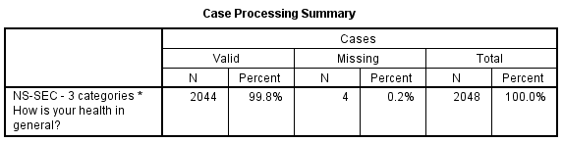
Social Class & Health II
Here are the two variables that we are testing for a relationship between
This is the number of cases that are ‘valid’ i.e. have useable values
This is the number of cases that are ‘missing’ i.e. data not available
This is the total number of cases in the dataset (including ‘valid’ and missing’)

Slide 131
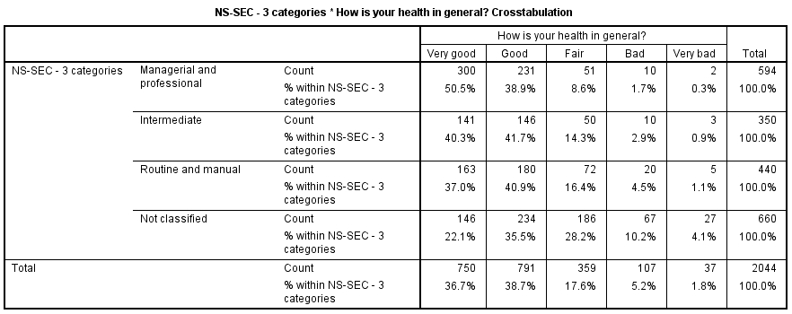
Social Class & Health III
Talk to the person next to you – what would you conclude from this table?

Slide 132
Social Class & Health IV
Sometimes tables can be difficult to interpret if they are large or when values only change for particular groups
Lucky for us there is a statistical test that will tell us whether the relationship between the variables is STATISTICALLY SIGNIFICANT

Slide 133
Social Class & Health V
The trick to interpreting the Chi-Square test (x²) is to see whether the ‘Asymptotic Significance (2-sided)’ value is greater than or equal to or less than 0.05
Greater than 0.05 = not significant
Equal to 0.05 = borderline significant (normally considered significant)
Less than 0.05 = significant
In effect we are asking the test whether social class has a statistically significant association with self-assessed general health
If the effect is not significant then the variables are clearly INDEPENDENT of each other (hence the name ‘Chi-Square test for independence’!)
We refer to the ‘Asymptotic Significance (2-sided)’ as the ‘p-value’

Slide 134
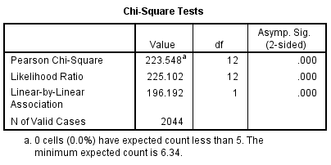
Social Class & Health VI
We can see from this table that the ‘Asymp. Sig. (2-sided)’ value is less than 0.05, therefore we know that there is a statistically significant association between social class and self-assessed general health

Slide 135
Crosstabulations & Chi-Square Summary
It is vital not just to report the statistic, but to discuss the nature of the relationship
Use the percentage values in the crosstabulation to do this
Whether you want row or column percentages depends on what you want to know – think carefully!
Check whether cells in the crosstabulation have values equal to or in excess of 5
Is the ‘Asymptotic Significance (2-sided)’, or p-value, equal to or less than 0.05? i.e. is it significant?
But the best way to learn this is to do it yourself!

Slide 136
Group Activity – Tell Us Something Interesting!
Working in pairs run a series of chi-square tests to investigate relationships that you think might be interesting
To run a chi-square test go to ‘Analyze’, ‘Descriptive Statistics’ and ‘Crosstabs’
Click on ‘Statistics’ and ensure that ‘Chi-Square’ is selected
Click on ‘Cells’ and ensure that ‘Observed’, and ‘Row’ are ticked
Drag and drop one variable into the ‘Row(s)’ field. Drag and drop the other variable into the ‘Column(s)’ field. Don’t put more than one variable in any single field.

Slide 137
Choosing Tests - One Interval Variable
YES
ANOVA
Is the interval variable normally distributed?
YES
NO
Kruskal-Wallis
YES
Independent Samples T-Test
Do you have more than two groups?
Is the interval variable normally distributed?
YES
NO
NO
Mann-Whitney U
Are the groups independent?
YES
Related Samples T-Test
Do you have more than two groups?
NO
Is the interval variable normally distributed?
NO
NO
Wilcoxon Signed Rank
YES
Repeated Measures ANOVA
Is the interval variable normally distributed?
YES
NO
Friedman Test

Slide 138
Give Yourself a Pat on the Back!
We just been through half of a 20 credit module in 2.5 days
Hopefully you should now:
  feel more confident in discussing quantitative methods
  feel more confident in supervising quantitative projects
  be able to consider how quantitative methods might enhance your existing research
It doesn’t matter if you’ve forgotten the SPSS exercises already – it’s more important that you’re aware of what can be done.
There are a whole raft of resource on using SPSS available online, some YouTube tutorials are particularly good

Slide 139
Evaluation
Could you please list on a piece of paper:
  One thing you want us to stop doing
  One thing you want us to start doing
  One thing you want us to carry on doing
Please put your feedback in the box provided and feel free to add anything else you want to say that might be of use (please be honest!)

Slide 140
Quantitative Research for Qualitative Researchers
8th-10th January 2019
Cardiff University
End of Day Three!

